Slide 1

Basic Concepts in Government Ethics
Carla Miller, Network Fellow (2013-15)
Founder, City Ethics www.cityethics.org
Creative Commons

Slide 2
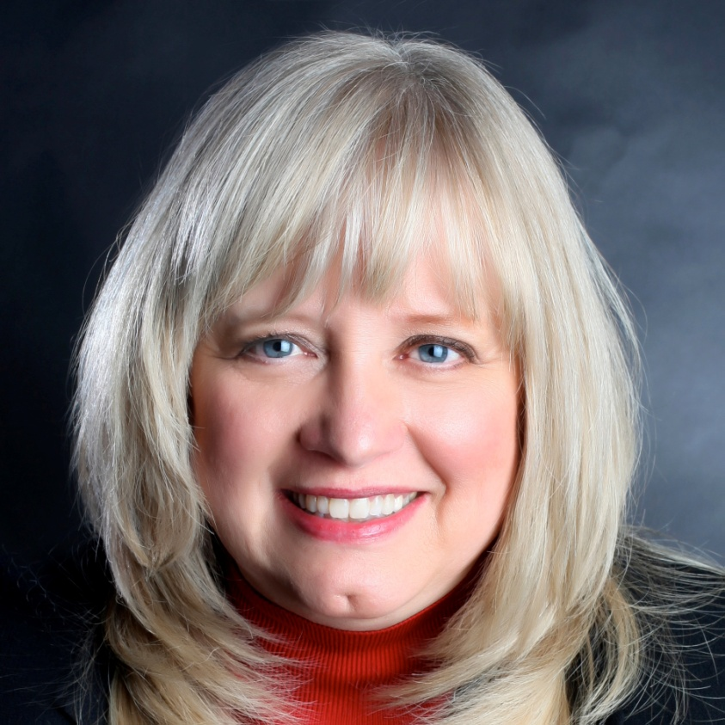

Hello from Florida….
Notes:
Hello,
My name is Carla Miller and I live in Jacksonville, Florida. I am an attorney and former federal prosecutor. I have worked in municipal ethics for the last 15 years and I am the founder of City Ethics– www.cityethics.org
From 2013-2015 I was a Network Fellow at the EJ Safra Center for Ethics at Harvard.
I am passionate about the subject of government ethics and I hope this PowerPoint will be of interest to you. In my experience, I think it helps to have the “big picture” before learning the ethics rules in your city. (This is an intro to the subject; your city attorney will follow this up with specific conflict rules.)
SO HOW EAGER ARE YOU TO BE SITTING IN AN ETHICS SEMINAR TODAY ON A SCALE OF 1-5. (5 –YOU WISH YOU COULD STUDY THIS ALL WEEK, IT IS SO FASCINATING; 1—IF YOU CAN BE ON YOUR CELL PHONE, TEXTING, etc., MAYBE YOU CAN LIVE THROUGH IT.)

Slide 3
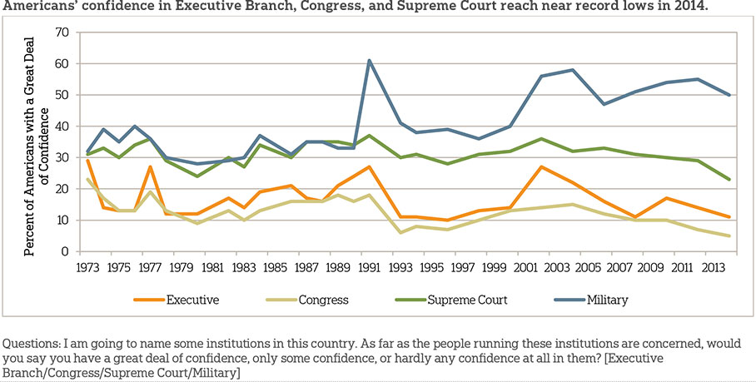
Trust in Government
Notes:
FIRST, A FEW WORDS ABOUT TRUST IN GOVERNMENT. THIS GRAPH SHOWS SOME RECENT SURVEY RESULTS ON HOW MUCH WE TRUST CERTAIN ORGANIZATIONS.
UP AT THE TOP IS MILITARY; THEN THE SUPREME COURT. THEN WE DIP TO THE EXECUTIVE BRANCH AT ABOUT 10%.
BUT THE LOWEST IS CONGRESS, AT 5% TRUST RATE. THIS IS AT AN ALL TIME LOW.
AND LET’S TAKE A LOOK AT A MORE GRAPHIC STUDY

Slide 4
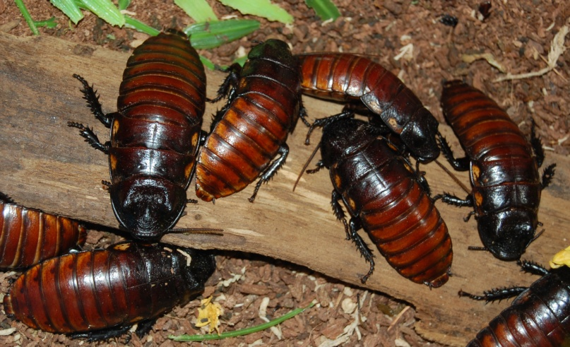
Survey
What do you have a higher opinion of:
Congress or cockroaches?
1. Cockroaches....... 45%
2. Congress ............ 43%
3. Not sure ............ 12%
Public Policy Polling 2013
Notes:
THIS IS A STUDY OF WHAT PEOPLE LIKE AND DISLIKE.
AND YOU CAN SEE HOW CONGRESS RATED; COCKROACHES ARE MORE POPULAR!

Slide 5
SURVEY
Do you think that citizen trust in government can be improved?
Do you think you can do anything personally to improve citizen trust in government?
Notes:
IN A STUDY IN MASSACHUSETTS, PUBLIC EMPLOYEES WERE ASKED IN A PRE-TRAINING SURVEY ABOUT THEIR HOPE FOR IMPROVEMENT IN THIS SITUATION AND WHETHER THEY THOUGHT THEY COULD PERSONALLY DO SOMETHING ABOUT THIS SITUATION. THERE WAS MILD HOPE…. AND AS A GROUP, THEY STILL CARED AND WANTED TO MAKE THINGS BETTER.
HOW DO YOU FEEL ABOUT THESE QUESTIONS? (CAN BE SURVEYED IN THE GROUP BY RAISE OF HANDS OR IN A PAPER SURVEY.)
HOPEFULLY, THIS COURSE WILL GIVE YOU SOME TOOLS TO HELP YOU INCREASE PUBLIC TRUST IN GOVERNMENT.

Slide 6

Is there Hope?
Notes:
SO, IS THERE HOPE? YES.

Slide 7
CHALLENGES IN ETHICS TRAINING
Notes:
THERE ARE A FEW CHALLENGES THOUGH IN LEARNING ABOUT GOVERNMENT ETHICS THAT WE SHOULD TAKE A LOOK AT.

Slide 8

Challenge #1: All I need to know about ethics I learned in Kindergarten
Notes:
I HEAR THIS A LOT. AND IT STEMS FROM A MISUNDERSTANDING THAT MOST PEOPLE HAVE.

Slide 9


2 CONCEPTS OF ETHICS
Personal Organization
Notes:
THERE ARE 2 KINDS OF ETHICS WE ARE DISCUSSING; ONE IS PERSONAL ETHICS AND THE OTHER IS THE ETHICS OF THE ORGANIZATION ITSELF.

Slide 10
Personal Ethics/Values
Honesty
Respect
Fairness
Integrity
Morals
Hardworking
Notes:
LET’S TAKE A LOOK AT “PERSONAL ETHICS”. THIS IS VERY IMPORTANT AND IS THE BASIS OF HOW WE DEAL WITH OTHER PEOPLE, FACE TO FACE.
IF YOUR DEPARTMENT HAS PROBLEMS WITH THIS, IT CAN MAKE YOUR DAY MISERABLE; YOU COMPLAIN WHEN YOU GET HOME ABOUT HOW YOU WERE TREATED, YOU WANT TO QUIT. THIS CAN BREAK DOWN MORALE, AND IT IS A VERY IMPORTANT TOPIC, BUT NOT THE ONE WE ARE GOING OVER TODAY.

Slide 11
Organization Ethics/Values
No conflicts—independent judgment
Transparency
Fairness
No Personal Gain
Notes:
WHAT WE ARE LEARNING TODAY IS “GOVERNMENT ETHICS” OR THE ETHICS OF THE INSTITUTION. ALTHOUGH RELATED TO PERSONAL ETHICS, THE VALUES ARE DIFFERENT AND RELATE TO HOW PEOPLE VIEW THEIR GOVERNMENT.

Slide 12
You can be “ethical” on a personal level by giving gifts or getting a job for a friend, but this could violate government ethics standards.
Personal ethics is different from government ethics!! Your instincts may not be right.
Notes:
SO YOU CAN ACTUALLY BE DOING WHAT YOU THINK IS ETHICAL ON A PERSONAL LEVEL, BUT VIOLATING GOVERNMENT ETHICS STANDARDS. FOR EXAMPLE, WE ARE USED TO GIVING AND RECEIVING GIFTS IN OUR PERSONAL LIVES. WE ARE TRAINED TO ACCEPT GIFTS AND BE POLITE; SAYING “THANK YOU”. BUT IN THE GOVERNMENT, THIS COULD VIOLATE ETHICS RULES. WHY? BECAUSE WE DON’T WANT PEOPLE TO THINK SOMEONE GETS BETTER TREATMENT IF THEY GAVE A CITY EMPLOYEE A GIFT.
OR IF YOU HELP SOMEONE GET A JOB, THAT MAY GENERALLY BE A GOOD THING, BUT NOT IF YOU ARE A GOVERNMENT EMPLOYEE

Slide 13
#1 Value for Government Ethics?
Notes:
SO, WHAT DO YOU THINK THE #1 VALUE IS IN GOVERNMENT ETHICS?

Slide 14
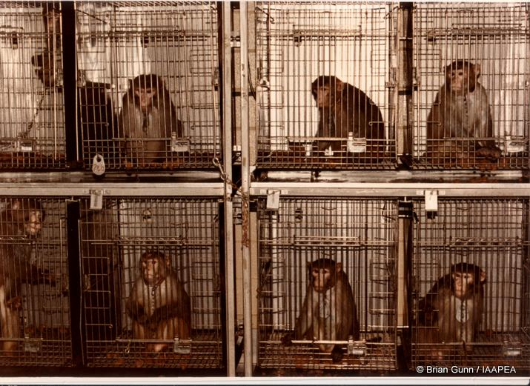
Notes:
I’LL SHOW YOU AN ANSWER WITH THE FAMOUS “MONKEY STUDY”.
IMAGINE THAT THE MONKEYS ARE CITIZENS.
THEY WERE ALL TRAINED TO GIVE A ROCK TO A PERSON AND THEN THEY WOULD GET A FOOD REWARD.

Slide 15

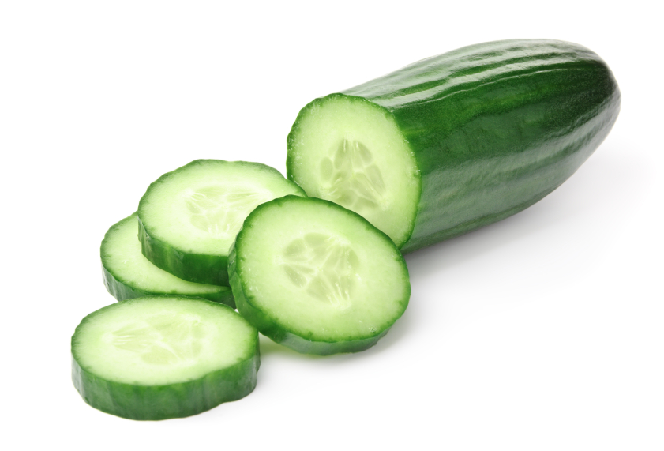
Notes:
SO, GIVE A ROCK, GET A SLICE OF CUCUMBER.

Slide 16

Notes:
BUT THEN, THEY CHANGED THE REWARD FOR SOME OF THE MONKEYS. MONKEYS LOVE GRAPES. SO WHEN SOME OF THE MONKEYS GAVE A ROCK, INSTEAD OF CUCUMBER, THEY GOT A GRAPE!

Slide 17
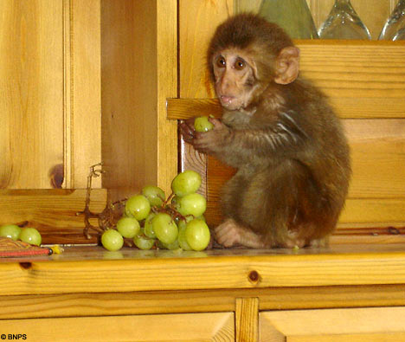
Monkey Fairness Study YouTube
Notes:
HERE IS A YOU TUBE VIDEO OF WHAT HAPPENED WHEN THEY DID THIS—GIVING A GRAPE AS A REWARD. YOU CAN PROBABLY RELATE TO THIS MONKEY.

Slide 18
Inequity Aversion
Rejection of Injustice
It’s not FAIR !!!!!!
Notes:
RESEARCHERS HAVE STUDIED THIS A LOT; THEY CALL IT INEQUITY AVERSION—WE HATE IT WHEN WE ARE TREATED UNFAIRLY. THEY EVEN HAVE A MATHEMATICAL FORMULA FOR IT!
SO THE NUMBER ONE VALUE IN GOVERNMENT ETHICS IS FAIRNESS!!

Slide 19
Fairness is Key to our Form of Government
Violating fair procedures (corrupting the democratic process) is what ethics rules try to prevent
Notes:
EVERY SINGLE ETHICS RULE CAN BE TRACED BACK TO FAIRNESS. CITIZENS LOOK AT WHAT WE DO AS GOVERNMENT OFFICIALS AND GET A GUT FEELING AS TO WHETHER OR NOT WHAT HAPPENED WAS “FAIR”.

Slide 20
Challenge 2
“I’m busy. Ethics is something you have to do in training once a year; the rest of the time, I have to do my job—that’s what I have to keep my attention on. I have important issues to deal with. Who gets gifts and what the gift cost is so trivial…..”
Notes:
THIS IS ALSO WHAT PEOPLE SAY ABOUT ETHICS—THIS IS A WASTE OF TIME; I KNOW WHAT I AM DOING AND I AM TOO BUSY FOR THIS.

Slide 21

How to Distract Citizens
When there is an “ethics issue” time stops and all discussion focuses on what someone did to violate ethics standards
Forward motion on key issues stops; everyone is talking about the ethics problem
Notes:
CAN YOU THINK OF A TIME WHEN THERE WAS A POLITICAL SCANDAL AND THE POLITICIAN WAS FOCUSED ON DEFENDING HIS ACTIONS? HOW MUCH WORK DO YOU THINK GOT DONE DURING THAT TIME ON THE IMPORTANT PUBLIC POLICY ISSUES?

Slide 22
How important is Ethics?
Essential government goals are:
to get jobs for people, to educate children and to make sure we are safe, etc.
But, without ethics and rules on fairness, the “important” goals of government cannot be met. Therefore, Ethics is the foundation of all other public policy issues.
Notes:
WITHOUT AN ETHICAL FOUNDATION, ALL OF THE OTHER FUNCTIONS OF GOVERNMENT TEND TO BREAK DOWN.

Slide 23
Challenge #3
I already am ethical…
Notes:
HERE IS THE NEXT CHALLENGE. STUDIES SHOW THAT PEOPLE ALREADY THINK THEY ARE ETHICAL AND THAT WHEN A SITUATION COMES UP, THEY WILL NATURALLY DO THE “RIGHT THING”

Slide 24
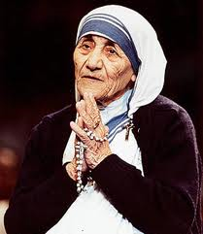
In fact, I have a better chance of getting into heaven than Mother Theresa
Notes:
A STUDY SHOWED THAT WHEN SURVEYED, MOST PEOPLE THOUGHT THEY STOOD A BETTER CHANCE OF GETTING INTO HEAVEN THAN MOTHER THERESA!
WHY IS THAT?
WE HAVE A VERY HIGH OPINION OF OUR ETHICS WHEN WE THINK ABOUT HOW WE ARE GOING TO ACT IN THE FUTURE.
BUT AT THE TIME OF THE ACTUAL DECISION, THERE ARE OTHER FORCES THAT ARE IN PLAY.

Slide 25
STAGES of an Ethical Decision
1
BEFORE THE DECISION
2
AT THE TIME OF THE DECISION
3
AFTER THE DECISION
Notes:
HERE ARE THE 3 STAGES;
BEFORE; WE KNOW WE WILL DO THE MOST ETHICAL THING;
AT THE TIME; WE ACT MORE ON SURVIVAL AND SUBCONSCIOUS FACTORS;
AFTERWARDS, WE JUSTIFY WHY WHAT WE DID WAS REALLY THE BEST THING

Slide 26
To make ethical decisions, you need to recognize your vulnerability to your own unconscious biases.
Notes:
SO THE LATEST RESEARCH IS IN THIS AREA—HOW TO RECOGNIZE YOUR BIASES; HOW NOT TO GET TRICKED WHEN YOU HAVE TO MAKE A DECISION. THAT COULD BE THE SUBJECT OF A WHOLE SESSION, BUT JUST MENTIONING IT HERE.

Slide 27

Blind Spots
Bazerman, Tennbruzel
Notes:
IF YOU WANT MORE DATA ON THIS, I RECOMMEND “BLIND SPOTS”. IT IS FUN TO READ AND YOU WILL UNDERSTAND THIS TOPIC BETTER AND SEE YOUR BIASES AND THOSE OF YOUR CO-WORKERS.

Slide 28
Challenge #4 Why am I here?
What is your purpose for learning about “government ethics”?
Notes:
ANOTHER KEY CHALLENGE IS TO SORT OUT WHY YOU ARE LEARING ABOUT GOVERNMENT ETHICS TO BEGIN WITH.
WHY ARE YOU HERE TODAY? STUDIES SHOW THAT THE MORE WE CARE ABOUT LEARING A SUBJECT, THE MORE WE ABSORB THE INFORMATION. THAT IS OBVIOUS.
SO WHY ARE YOU HERE TODAY LEARNING ETHICS? (THINK ABOUT IT FOR A MINUTE. (SURVEY GROUP FOR ANSWERS ON THIS)
HERE ARE SOME: HAVE TO COME TO THIS TRAINING; SENT BY OFFICE; YOU WANT TO LEARN THE RULES.
OTHERS?
LET’S TAKE A LOOK AT SOME IDEAS ON THIS.

Slide 29

Our History, Our Heritage
Notes:
One of the key goals of the 1787 Constitutional Convention in Philadelphia was the creation of checks and balances that would prevent corruption. Corruption was the topic of discussion in 25% of the Convention meetings. There was strong resentment at the time against the actions of King George III of Britain and his appointed "royal governors" who used their offices in America to enrich themselves and the King. Offices were bought and sold and land unfairly taxed. The accepted British and European culture at the time was to use your public office to make money for yourself, at the expense of the citizens. The English Parliament was not the voice of the people; it was the voice of the King. The American patriots waged a revolution to reverse this culture of corruption. They believed that public service required that officials put the interests of the people over their own private interests.

Slide 30
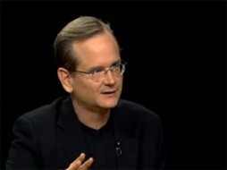
Larry Lessig, Harvard
The Framers viewed corruption as one of the greatest threats to government. As George Mason warned his fellow delegates at the Constitutional Convention, “I admire many parts of the British constitution and government, but I detest their corruption; and, if we do not provide against corruption, our government will soon be at an end.
Notes:
LARRY LESSIG, THE DIRECTOR OF HARVARD’S ETHICS LAB

Slide 31
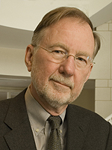
Dennis Thompson, Harvard
The Purpose of Government Ethics
Notes:
DENNIS THOMPSON, THE FOUNDER OF HARVARD’S ETHICS CENTER AND A WORLD AUTHORITY ON GOVERNMENT ETHICS HAS A GREAT CONCEPT OF THE PURPOSE OF GOVERNMENT ETHICS

Slide 32
Purpose of Government Ethics
To educate public employees about their important role in American Democracy. If they personally benefit from holding a public position, it leads to unfairness and a breakdown of our Democracy.
Notes:
(READ)

Slide 33
Challenge #5: But it’s LEGAL
Notes:
THE LAST CHALLENGE I WANT TO DISCUSS IS THIS ONE: WELL WE DIDN’T BREAK ANY LAW, SO IT MUST BE OK.

Slide 34

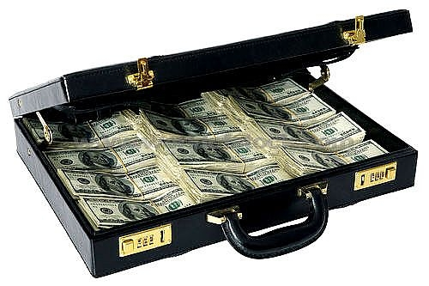
Notes:
WHEN WE HEAR THE WORD CORRUPTION, TYPICALLY WE THINK OF GROSSLY ILLEGAL ACTIVITIES. LIKE THE MOB, OR TAKING BRIBES, CASH IN SUITCASES.

Slide 35
CORRUPTION
CORRUPTION IS AN ABUSE OF PUBLIC POWER FOR PRIVATE GAIN THAT GOES AGAINST THE PUBLIC INTEREST. IT IS NOT ALWAYS ILLEGAL.
Notes:
BUT THE WORD HAS A BROADER MEANING. (READ THE DEFINITION ABOVE)
THE MAIN IDEA IS THAT POWER YOU HAVE AS A PUBLIC OFFICIAL CAN BE MISUSED FOR YOUR OWN BENEFIT; AND THIS CAN BE LEGAL! ALL CORRUPT ACTIVITIES ARE NOT ILLEGAL. SOMETIMES PEOPLE FIGURE OUT LOOPHOLES IN THE LAW. IT DOESN’T MAKE THE ACTIVITY OK; YOU JUST DON’T GO TO JAIL FOR IT. INSTEAD, IT CAN HIT THE FRONT PAGE OF THE NEWSPAPER.

Slide 36

HARVARD ETHICS CENTER
INSTITUTIONAL CORRUPTION
INFLUENCES THAT SHIFT PRIORITIES
WEAKEN THE ORGANIZATION
WEAKEN PUBLIC TRUST
That are legal.
Notes:
AN INTERESTING DEFINTION OF CORRUPTION COMES FROM THE HARVARD ETHICS CENTER. (READ)
LET’S SEE WHAT THAT LOOKS LIKE:

Slide 37

Notes:
THIS IS A DIAGRAM USED AT THE HARVARD ETHICS LAB TO DESCRIBE INSTITUTIONAL CORRUPTION.
IMAGINE A PUBLIC SERVANT AND A COMPASS. AS A GOVERNMENT WORKER, YOUR LOYALTY SHOULD BE 100% FOR THE CITIZENS, OR TRUE NORTH.

Slide 38


Influences that Shift Priorities
Notes:
BUT WHAT HAPPENS IS THAT POWERFUL INFLUENCES, LIKE A MAGNET, PULL YOU OFF OF TRUE NORTH; THERE IS A DEVIATION OFF OF THINKING ABOUT THE CITIZENS. INSTEAD, THINGS LEAN MORE TOWARDS POWERFUL INFLUENCES. YOU PROBABLY HAVE ALL SEEN A POLICY SHIFTED IN THIS WAY AND IT WASN’T TO THE BENEFIT OF THE CITIZENS.
FOR EXAMPLE, AND THIS IS AN EASY ONE, CONGRESS. LAST YEAR, OVER 3 BILLION WAS SPENT BY LOBBYISTS TO INFLUENCE CONGRESS-- MUCH OF IT FROM THE BANKING AND FINANCE INDUSTRIES. THAT AMOUNT OF MONEY CAN CERTAINLY INFLUENCE THE BOTTOM LINE ON LEGISLATION AND IT HAS. FINANCIAL SAFEGUARDS FOR CITIZENS HAVE BEEN WEAKENED BY CONGRESS, NOT STRENGTHENED. SO DO WE TRUST CONGRESS TO ACT IN OUR BEST INTERESTS?

Slide 39
The RULES….
Notes:
WE HAVE REVIEWED THE FOUNDATIONS OF WHY WE HAVE GOVERNMENT ETHICS RULES. HOPEFULLY, THE RULES WILL MAKE MORE SENSE TO YOU WITH THAT INFORMATION.

Slide 40

ETHICS LAWS
ARE ABOUT CONFLICTS
Notes:
JUST REMEMBER THAT GOVERNMENT ETHICS DO NOT COVER HOW TO BE A GOOD PERSON; INSTEAD THEY ARE ABOUT CONFLICTS YOU WILL HAVE BETWEEN YOUR PUBLIC LIFE AND YOUR PRIVATE LIFE.

Slide 41
CONFLICTS WILL HAPPEN-- HOW WILL YOU DEAL WITH THEM?
Notes:
REMEMBER, IT IS NOT WHETHER CONFLICTS WILL COME UP—THEY WILL. DON’T FREEZE AND PANIC!
IT IS HOW YOU DEAL WITH THEM THAT IS IMPORTANT.
CALL YOUR ETHICS COMMISSION OR CITY ATTORNEY TO DISCUSS

Slide 42
Conflict of Interest Law
Notes:
NOW, YOUR CITY ATTORNEY WILL COVER THE RULES AND THE MAIN DANGER AREAS.
THANK YOU FOR YOUR ATTENTION TODAY, I HOPE YOU FOUND THIS INFORMATION USEFUL.
(THIS CONCLUDES THE INTRODUCTION TO GOVERNMENT ETHICS; A MORE SPECIFIC TRAINING ON THE ACTUAL RULES CAN NOW BE ADDED TO THIS INFORMATION.)

